Slide 1
Cube humidity control
Rev 0
Author: A. Iaconis

Slide 2
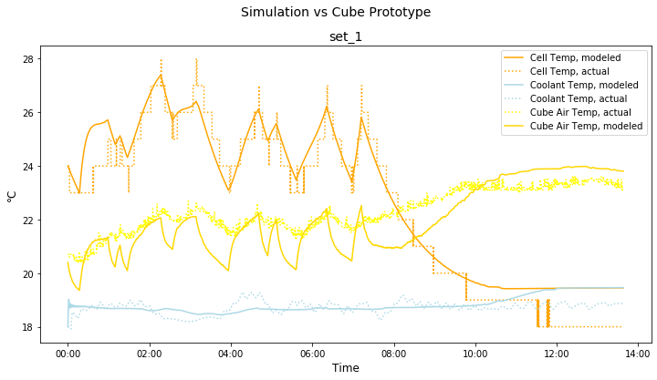
Measured behavior - example
Air between 20°C – 22°C
HVAC was not operational at this temperature
Coolant temperature at approx. 19°C
Need to consider min wet bulb temp around 17°C

Slide 3
Psychrometric Chart
As can be observed on the left, the highest relative humidity that can be tolerated at 22°C air temp is approx. 73% if we want to avoid any condensation on colder surfaces.
At higher air temperatures the max allowed relative humidity will be lower (e.g. at 25°C the max relative humidity should be 60%)
0.012 kg/kg humidity corresponds to 73% Rh at 22°C
17°C is the lowest coolant temperature
100% RH at 17°C = 0.012 kg/kg abs humidity

Slide 4
Humidity control method
The lowest coolant temperature of 17°C set as wet bulb temperature at which condensation would start to occur ( coolant temperature will be ≥17°C).
Some exposed surfaces may be available at the coolant temperature (e.g. cooling plate of battery modules)
The above will result in lower relative humidity thresholds at higher temperatures.
RH thresholds created for air temperature bins to assure non-condensation at 17°C
Method: Absolute humidity removal using the HVAC unit cooling.
De-humidification process is triggered when RH thresholds are exceeded for the corresponding air temperature bin.
Leaf Controller will read air temperature and RH and will control HVAC setpoints accordingly

Slide 5
Table of actions
Condition #1 [Tair] | Condition #2 [RH limit exceeded] | Set-point | Action until
Tair < 15°C | N/A | 15°C | Heat until Tair = SP
15°C < Tair < 18°C | RH > 85% | 15°C | [Cool until Tair = SP] OR [max 1h] OR [RH – 10%] (*)
18°C < Tair < 21°C | RH > 75% | 17°C | [Cool until Tair = SP] OR [max 1h] OR [RH – 10%] (*)
21°C < Tair < 24°C | RH > 62% | 20°C | [Cool until Tair = SP] OR [max 1h] OR [RH – 10%] (*)
24°C < Tair < 27°C | RH > 53% | 23°C | [Cool until Tair = SP] OR [max 1h] OR [RH – 10%] (*)
27°C < Tair < 30°C | RH > 45% | 25°C | [Cool until Tair = SP] (**)
T > 30°C | RH > 40% | 25°C | [Cool until Tair = SP] (**)
(*) any of the three conditions being met is sufficient to stop the de-humidification process
(**) when Tair is above 25°C, the HAVC remains at its normal set-point of 25°C

Slide 6
SW Control logic
start
Change set-point to 25°C
Set dehumidification FLAG = 0
Change SET POINT as per table
Read T, HR
Read T, HR
Set dehumidification FLAG = 1
Any of 3 action until met?
Conditions #1 & 2 met?
N
Y
N
Y
Start Time Counter

